Slide 1


Salesforce Developer Roadmap
Welcome! This roadmap, created by Gowtham Palaniappan, guides you to becoming a Salesforce CRM developer. Discover how to navigate the popular Salesforce platform. Learn about the growing demand for Salesforce professionals and unlock your potential.
by Gowtham Palaniappan

Slide 2
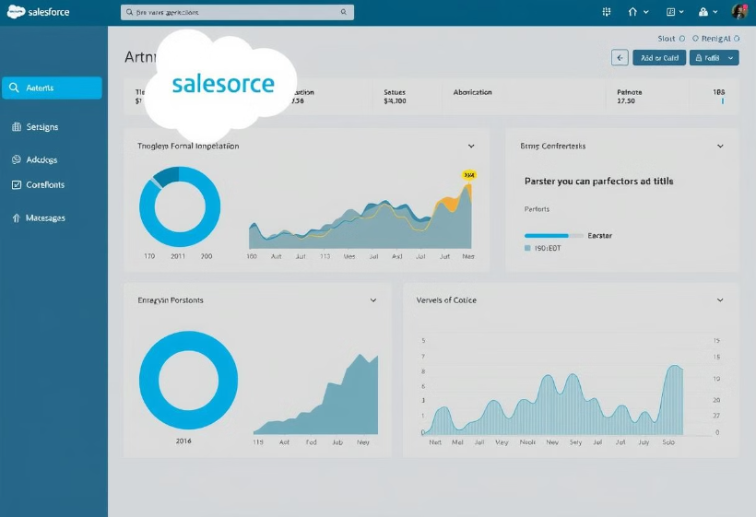
Getting Started: Salesforce Fundamentals
Master the Basics
Begin by becoming a proficient Salesforce Administrator.
Gain a thorough understanding of the platform.
Master the ready-made features.
Resources
Utilize Trailhead and free online resources for learning.

Slide 3
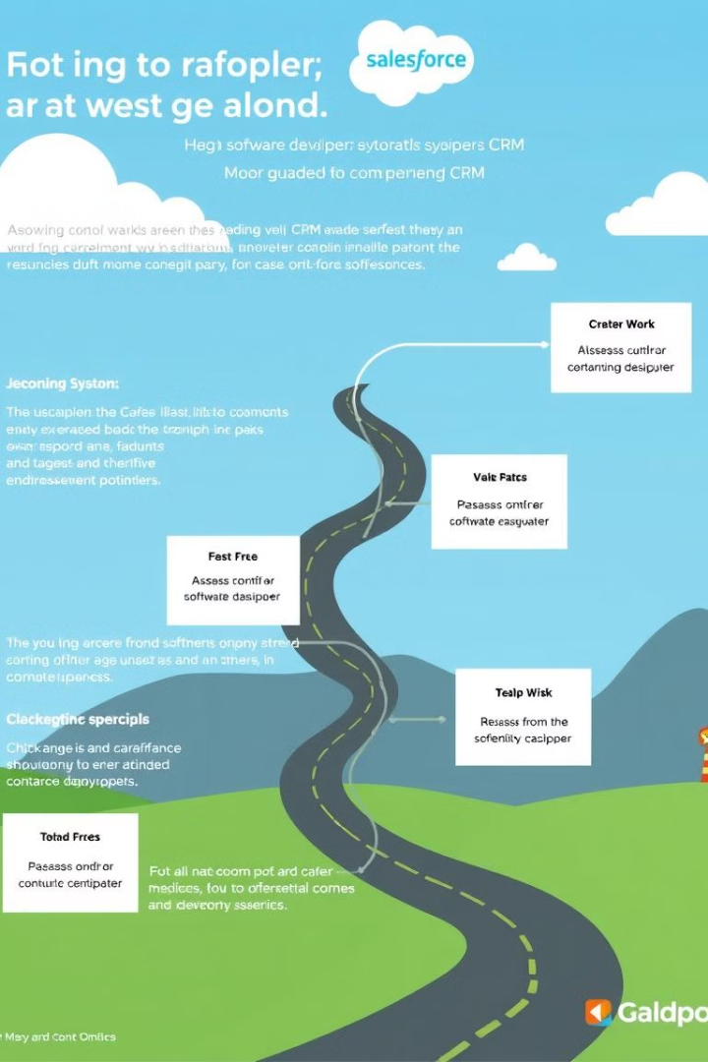



Choosing Your Career Path
Self-Assessment
Developer Path
Evaluate your interests and skills.
If you love coding, consider the developer path.
Diverse Options
Explore roles like Developer, Consultant, or Business Analyst.

Slide 4




Certification Journey
Admin
Salesforce Certified Administrator.
Developer
Salesforce Certified Developer.
JavaScript
JavaScript Developer I.
Key certifications unlock career opportunities.
Entry-level options include Platform Developer I and II.

Slide 5
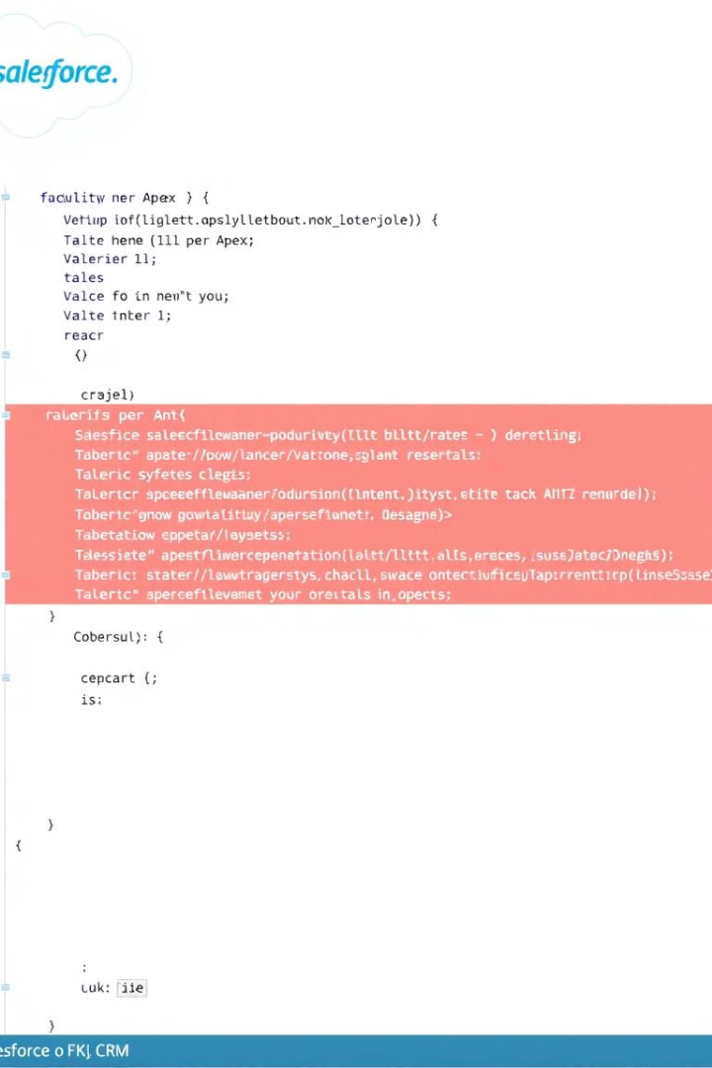



Technical Skills Development
Coding
Learn Apex, JavaScript, and Aura.
Lightning Web Components
Master Lightning Web Components.
Customization
Customize applications to client needs.

Slide 6

Career Opportunities
52.3K
165%
Job Postings
Job Growth
Available in the U.S. in 2021.
Job growth in the last 5 years.
$100K+
Entry Salary
Potential for administrators.

Slide 7
RoadMap for Salesforce Admin and Developers
Admin
1
Master Salesforce setup, configuration, and user management. Understand profiles, roles, permissions, and security settings. Configure standard objects and fields. Create custom objects and fields. Build reports and dashboards.
Developer
2
Learn Apex, Visualforce, and Lightning components for custom solutions. Develop custom Apex classes and triggers. Build Visualforce pages and components. Create Lightning Web Components (LWCs) and Aura components. Use Salesforce DX for source-driven development.
Advanced Developer
Architect complex systems, integrate with external platforms, and lead development teams. Design scalable and maintainable solutions. Integrate Salesforce with external systems using REST and SOAP APIs. Implement advanced security patterns. Lead and mentor development teams. Optimize performance and scalability.
3
This roadmap visualizes the topics and skills you need to learn to go from Salesforce Administrator to Advanced Salesforce Developer.

Slide 8








Your Salesforce Success Journey
Certifications
Expertise
Salary
Opportunities
Unlock better job opportunities and higher salaries with industry-recognized certifications. Start your journey today!

